Slide 1
The climate & health quiz
Notes:
Tip: for the bonus questions, print and cut out the categories before you start the quiz.

Slide 2
Objectives
Have fun
Test your knowledge
Learn more
Maybe - win a prize!

Slide 3
First: Pick your team (2 teams)

Slide 4
Now we need a score keeper…

Slide 5
Rules
Create teams of 2 or 3 in the group
First show all slides with questions only.
Teams have 1 min max to answer each question.
Answers are kept secret by each group
After the final question, ask each group to pass their answers to another group (to avoid cheating)
Then show all slides with answers and have each group correct and tally points of the neighboring group.
Declare a winner.
Notes:
Tip: ask the whole team to discuss and agree and pick a different person each time to answer.

Slide 6
Let’s play!

Slide 7
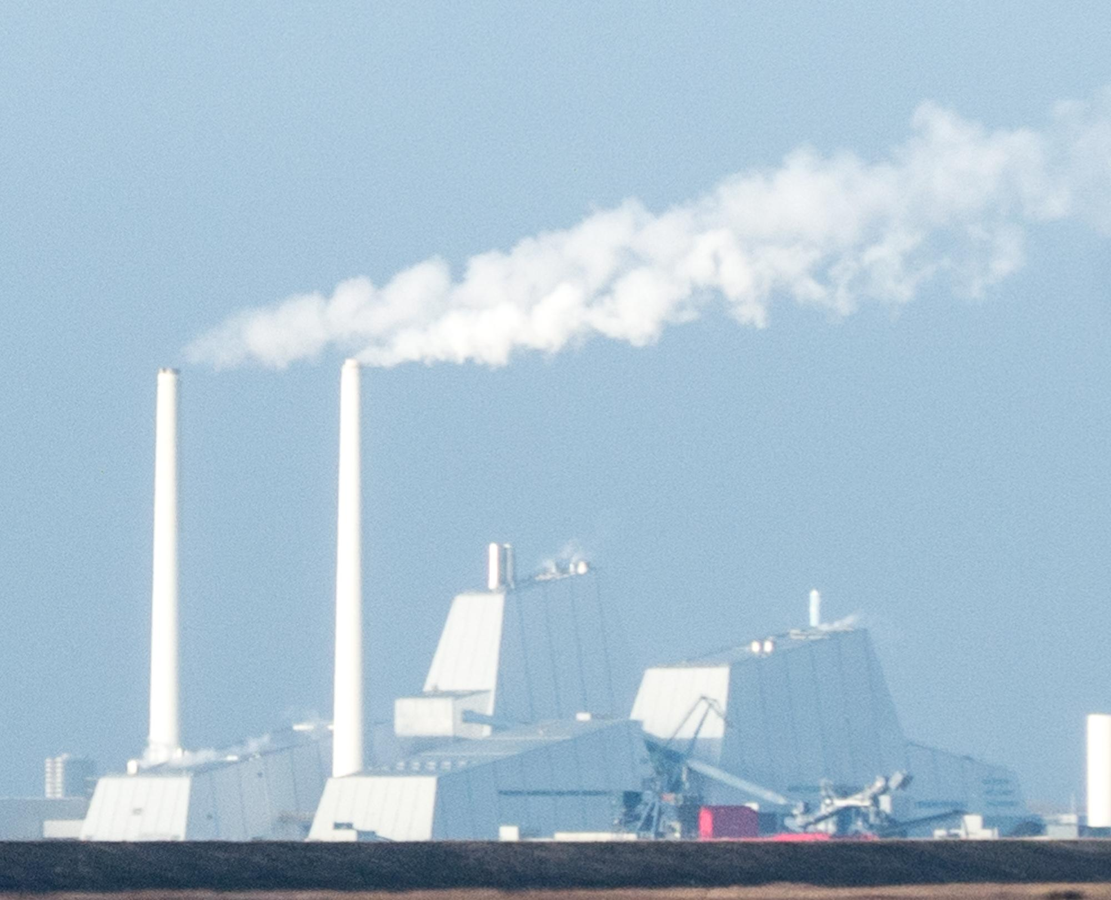
QUESTION 1 – True or False?
Human contribution to changes in climate already witnessed is uncertain…
Question worth 2 points

Slide 8
QUESTION 1 – True or False?
Human contribution to changes in climate already witnessed is uncertain…
The Intergovernmental Panel on Climate Change (IPCC) considers that “human influence on the climate is clear”.
There is already evidence that global temperatures are increasing and the climate is changing as a result of human activity (greenhouse gas release and land use).

Slide 9
QUESTION 2 – True or False?
Climate change already contributes a proportion of excess morbidity and mortality globally
Question worth 2 points

Slide 10
QUESTION 2 – True or False?
Climate change already contributes a proportion of excess morbidity and mortality globally
The World Health Organization (WHO) states that "climate change is already impacting human health and has become the largest health crisis of our time".
Notes:
Reference

Slide 11
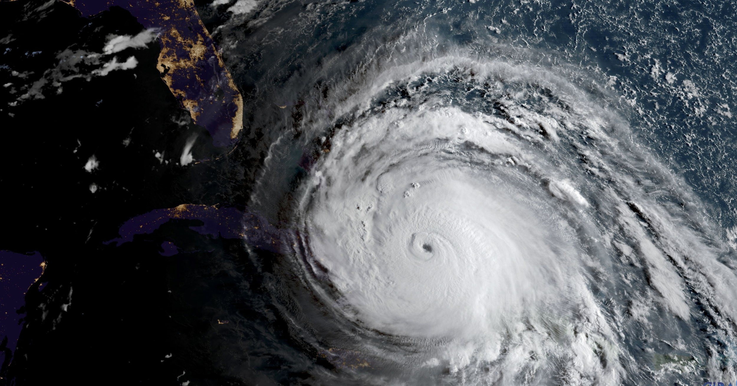
QUESTION 3 – True or False?
As a result of climate change, extreme weather events are expected to increase both in frequency and intensity
Question worth 2 points
Image: NASA
Notes:
Reference

Slide 12
QUESTION 3 – True or False?
As a result of climate change extreme weather events are expected to increase both in frequency and intensity
Extreme events such as flooding or drought are expected to increase both in frequency and intensity as a result of climate change. However, there is uncertainty about when and where these changes will happen and the impact they will have.

Slide 13
QUESTION 4 – Best Guess
How many people are expected to be in need of humanitarian assistance as a result of climate change by 2050?
The team that is the closest scores 2 points!
Hint: They were 108 million in 2019.

Slide 14
QUESTION 4 – Best Guess
How many people are expected to be in need of humanitarian assistance as a result of climate change by 2050?
IFRC estimates that 200 million people could require humanitarian assistance annually by 2050, which is twice as many as today.
Notes:
Not every day? Annually
Add reference

Slide 15
QUESTION 5 – Classify
Direct Effects
Impacts through natural systems
Impacts through socio-economic systems
Widening inequalities
Food & water insecurity
Extreme weather events
Distributional shifts of vectors, hosts and pathogens
Air pollution
Heatwaves
1 point per correct answer!

Slide 16
QUESTION 5 – Classify
Direct Effects
Impacts through natural systems
Impacts through socio-economic systems
Extreme weather events
Air pollution
Food & water insecurity
Distributional shifts of vectors, hosts and pathogens
Heatwaves
Widening inequalities
Notes:
Conflicts due to natural systems are a contentious topic so I replaced it with inequalities
Reworded the second cullet in natural systems box

Slide 17
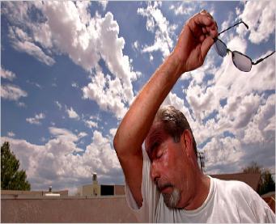
QUESTION 6 – True or False?
Impacts of heatwaves remain the same in high humid conditions
Question worth 2 points
Notes:
I am not sure what you mean by this? Physiologically this cannot be generalised? I would reword to Impacts of heatwaves are exaggerated in humid conditions?

Slide 18
QUESTION 6 – True or False?
Impacts of heatwaves remain the same in high humid conditions
Heatwaves are deadlier when they occur with higher humidity. When it is humid, it feels hotter, and the body is not able to cool itself.
Notes:
Reference

Slide 19
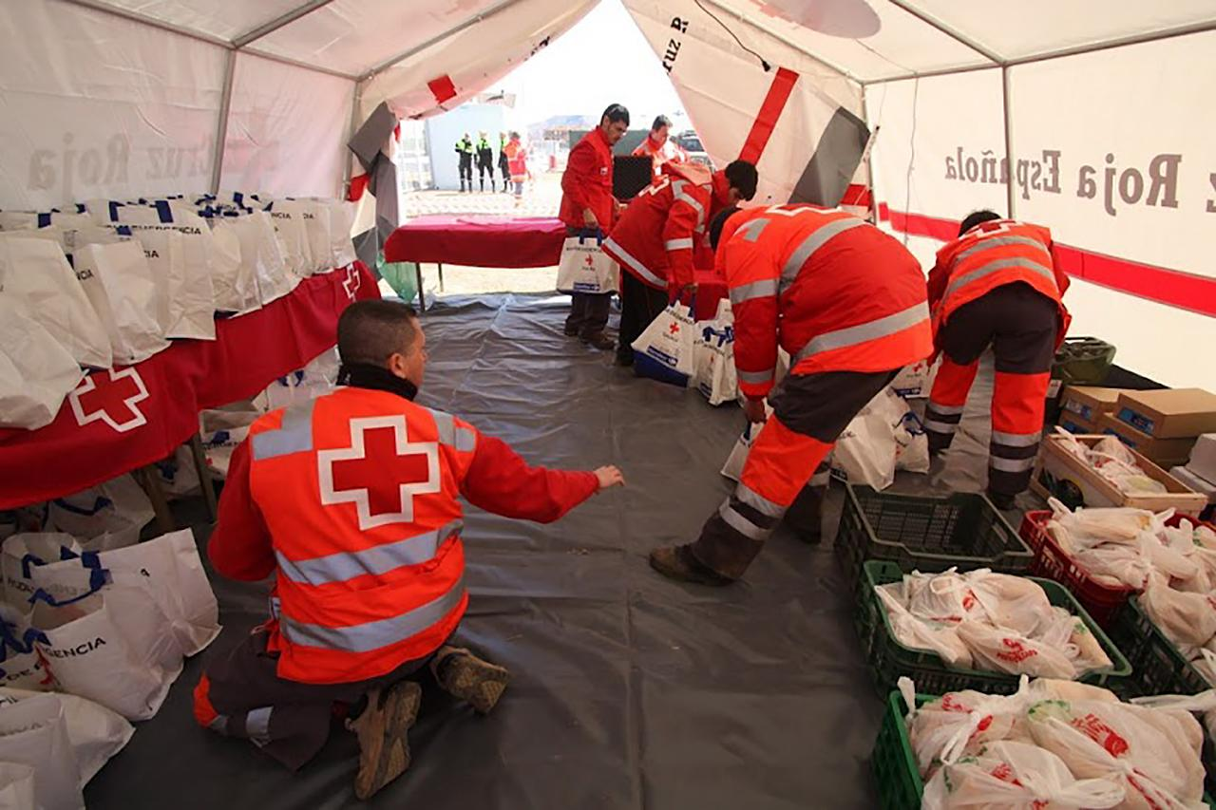
QUESTION 7 – List
Among the following groups of people, which ones are more vulnerable to heatwaves?
Elderly people
People working outside
People with air conditioners in their homes
People with pre-existing conditions
People living in rural settings
People in prison
1 point per correct answer!
Notes:
A/C replaced with air conditioners

Slide 20
QUESTION 7 – List
Among the following groups of people, which ones are more vulnerable to heatwaves?
Elderly people
People working outside
People with air conditioners in their homes
People with pre-existing conditions
People living in rural settings
People in prison

Slide 21
QUESTION 8 – Best Guess
How many people died during the heatwave that struck Europe in 2003?
The team that is the closest scores 2 points!
Notes:
I would swap with how many people are exposed to heatwaves every year?

Slide 22
QUESTION 8 – Best Guess
How many people died during the heatwave that struck Europe in 2003?
Over 70,000 people died in the 2003 heatwave in Europe.
Even in regions where the heath system is very developed, heatwaves can be extremely deadly.

Slide 23
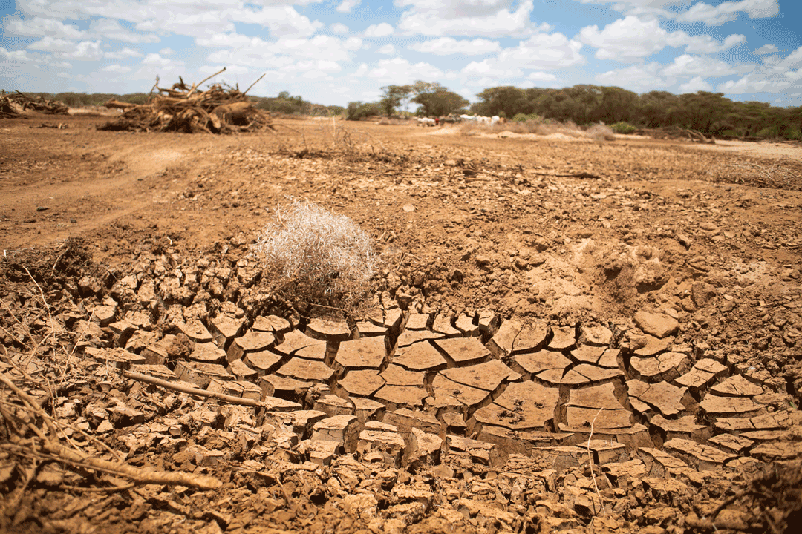
QUESTION 9 – List
Which of the following risks are associated with droughts?
Malnutrition
Cancer
Diarrhea
Cholera
Malaria
Migration
Stroke
Source: IFRC
1 point per correct answer!
Notes:
Reworded the question

Slide 24
QUESTION 9 – List
Which of the following risks are associated with droughts?
Malnutrition
Cancer
Diarrhea
Cholera
Malaria
Migration
Stroke
Source: IFRC

Slide 25
QUESTION 10 – True or False?
Temperature rise can intensify the negative health effects of air pollution
Question worth 2 points
Notes:
Heat and sunshine replaced with temperature rise

Slide 26
QUESTION 10 – True or False?
Temperature rise can intensify the negative health effects of air pollution
Heat exacerbates urban air pollution, with almost all cities in low- and middle-income countries failing to meet WHO guidelines on air quality.
Notes:
Add something about ozone
Add Reference

Slide 27
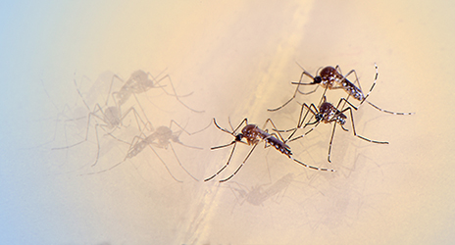
QUESTION 11 – True or False?
Warmer temperatures cause mosquitoes to die faster
Question worth 2 points
Source: IFRC
Notes:
Faser replaced with faster

Slide 28
QUESTION 11 – True or False?
Warmer temperatures cause mosquitoes to die faster
It depends! An increase in temperature can affect mosquito development in many different ways. The vast majority of those changes allow mosquitoes to be more effective vectors (survive longer, fly further, bite more) although in some cases higher temperature can increase mosquito mortality.
Notes:
Add reference

Slide 29
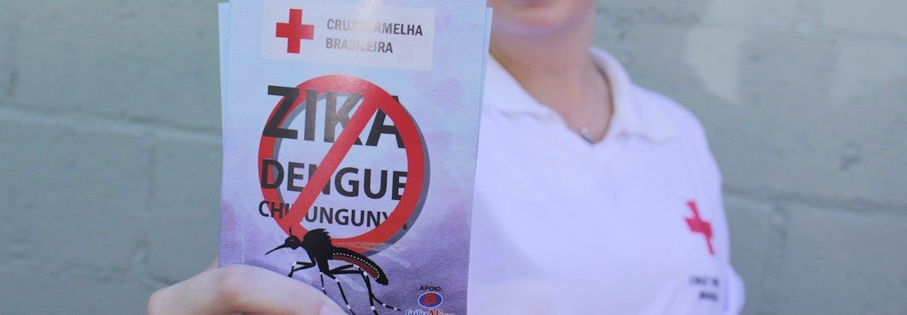
QUESTION 12 – True or False?
As a result of climate change, some vector-borne diseases might expand to areas where they are currently absent
Question worth 2 points

Slide 30
QUESTION 12 – True or False?
As a result of climate change, some vector-borne diseases might expand to areas where they are currently absent
Yes, for example with temperature variations mosquitoes might migrate to areas which were historically too cold, and start spreading malaria there. That is concerning since populations that are newly exposed to an infectious disease may lack premunity and experience severe forms of the disease with more adverse events compared to areas with endemic disease
Notes:
Reference and give examples of Highlands of Kenya as example for malaria transmission?

Slide 31
Final Challenge
Name five health consequences of climate change that your country or region is exposed to
1 point per health consequence identified!

Slide 32
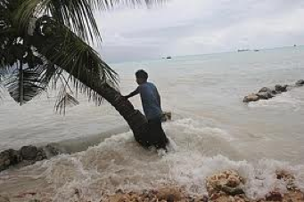
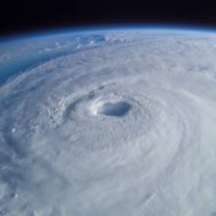
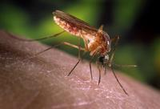
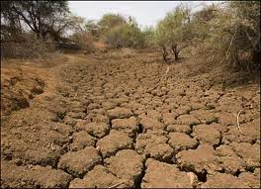
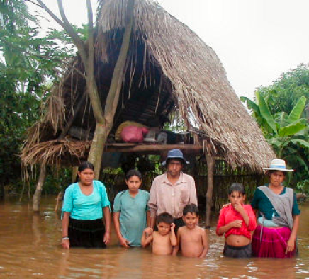
Let’s hear from each team! One point for every health consequence identified
Impacts listed that the facilitator finds questionable or do not have a logical justification will be tabled for further research (no points).
Notes:
Injury / Mortality (from extreme weather events etc.)
Vector-borne diseases (eg. malaria, dengue, zika, etc.)
Water-borne diseases
Non communicable disease
Mental health
Malnutrition
Reproductive, Maternal and Child Health

Slide 33
Let’s tally the points…

Slide 34
Congratulations!!
We hope all teams had fun learning

